Slide 1
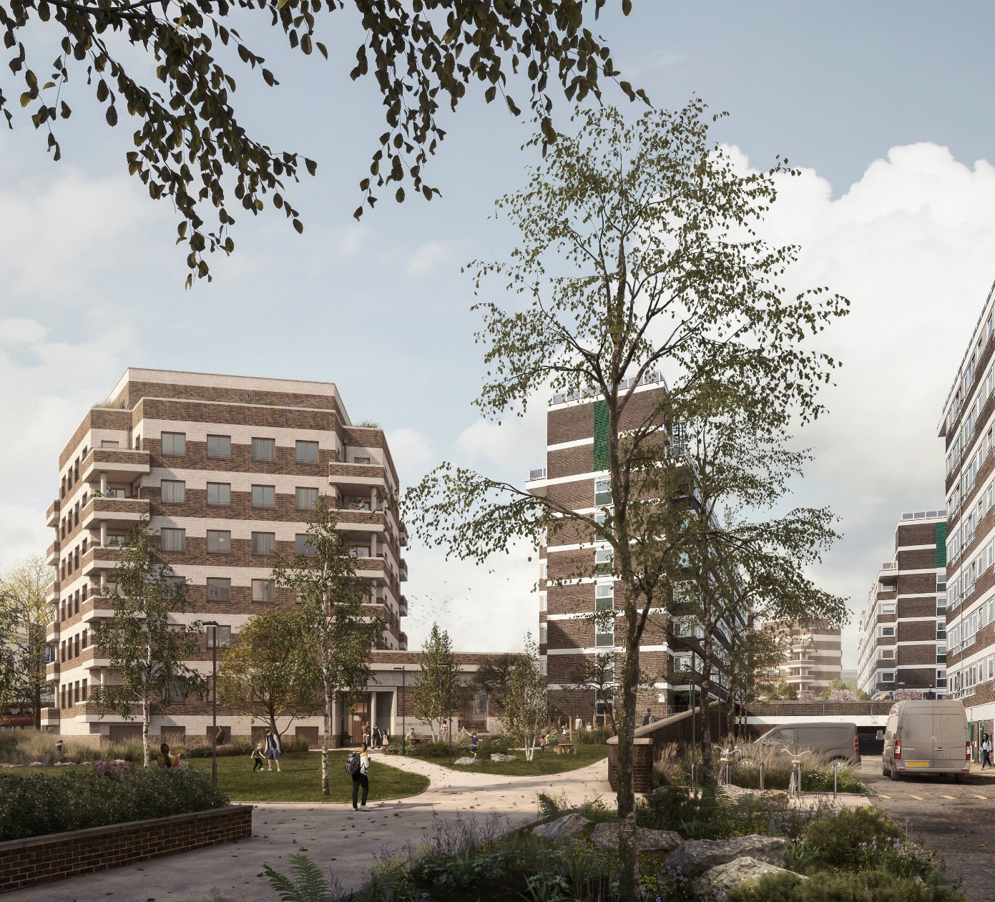
May 2023
York Way Estate
CONTRACTOR’S NEWSLETTER
www.yorkwayestate.com
www.higginspartnerships.co.uk

Slide 2
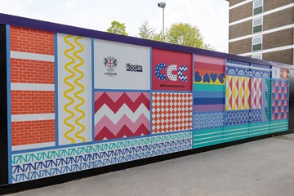
YORK WAY ESTATE, NEWSLETTER 5
May Key Milestones
We are pleased to announce that our Resident’s Respite Centre is now open to those living on the York Way Estate! It is open Monday to Friday between 10am and 4pm and can be found by the Market Road entrance to the estate (orange door). This new facility is for all residents to work or relax away from any disruption caused by the construction. Please pop in and meet your Resident Liaison Officer, Ruzi Bibi, if you have any questions or concerns about the development
There will be additional lighting added to the hoarding
Removal of play equipment and demolition of ball court
The hoarding artwork mural to the east side of Kinefold House is now complete.
May/June Look Ahead Programme
 | Anticipated Start Date | Anticipated Completion Date
Ground Source Heat Pumps (GSHP) drilling and trenching continues to east side of Lambfold, Penfields House and north of Shepherd’s House | May 2023 | June 2023
Ventilation/ tree pit openings to be cut into the podium to the west side of Kinefold House | May 2023 | June 2023
Groundworks (piling for foundations) starting to all sites | May 2023 | June 2023
Hoarding Art Work
The Hoarding Community Mural painting is now completed and we would like to thank Rose and her colleague from CCC for this amazing work it really looks astonishing.
There will be further workshops for an additional hoarding mural held this summer, open to local schools and the whole community please do look out for future newsletters for updates of how to get involved.
2
www.yorkwayestate.com
www.higginspartnerships.co.uk

Slide 3
YORK WAY ESTATE, NEWSLETTER 5
Site Communication
We seek to limit disruption to all residents and neighbours whilst the works are in progress.
We will ensure that the site is operated in a safe and secure manner, with controlled deliveries and noise suppression devices on all plant and machinery.
We will monitor noise, dust and vibration levels daily.
We will be sending out monthly newsletters to all residents with updates on the works.
If you experience any issues or have questions about the construction works, please contact the Resident Liaison Officer (RLO) by phone, email or in person.
Our RLO, Ruzi Bibi is based on site Monday to Friday 9-5pm and is based in the RLO/Respite Centre.
The RLO Office/Resident Respite Centre is now open and available to all Residents of York Way from 10am to 4pm.
We would like to have a coffee morning with the residents as an introductory to the respite centre. This session will help us engage with the community make everyone feel good and feel free to use the respite centre when needed.
Wider Community Engagement
Our success depends on our partnerships with others in the construction supply chain which include; CITB, Considerate Constructor Scheme, The National Skills Academy, Armed Forces, Building Lives, Women into Construction and more.
If you would like more information or to discuss any ideas, please contact us using the contact details on page 4.
3
www.yorkwayestate.com
www.higginspartnerships.co.uk
Notes:
3

Slide 4
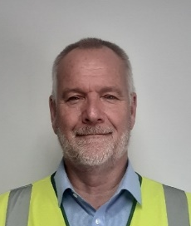
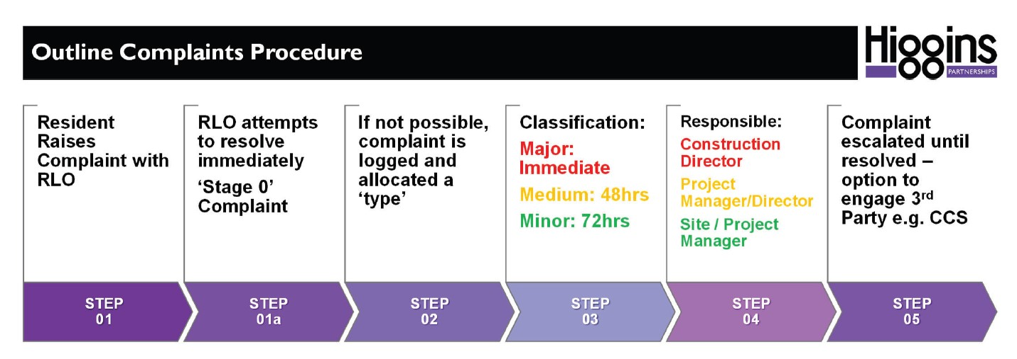
YORK WAY ESTATE, NEWSLETTER 5
Site Contacts During Working Hours
Ruzi Bibi
Resident Liaison Officer
07773 540 602
yorkway@higginspartnerships.co.uk
Tony Read
Site Manager
yorkway@higginspartnerships.co.uk
Working Hours
Our contracted hours of work are:
08.00 – 18.00 Monday – Friday
08.00 – 13.00 on Saturdays (only under exceptional circumstances)
We will not be working on Sundays or Bank Holidays
If you see any suspicious activity or anyone on site after hours please contact Bridge Security Emergency out of hours and state ‘York Way’: 0871 750 3001
www.yorkwayestate.com
4
www.higginspartnerships.co.uk

